Slide 1
SQL

Slide 2
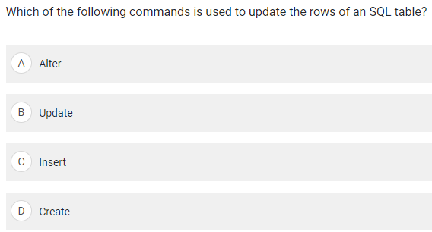
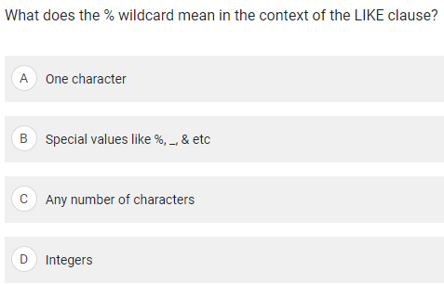
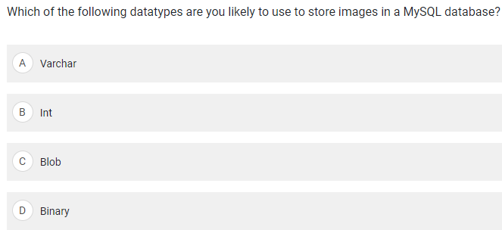
In MySQL, the preferred data type for image storage is BLOB
BLOB: Can handle up to 65,535 bytes of data.

Slide 3
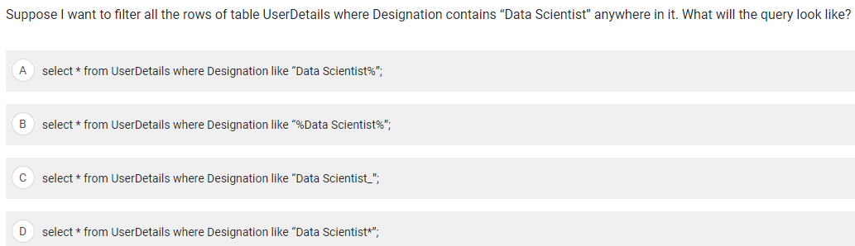
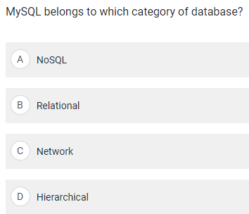


Slide 4
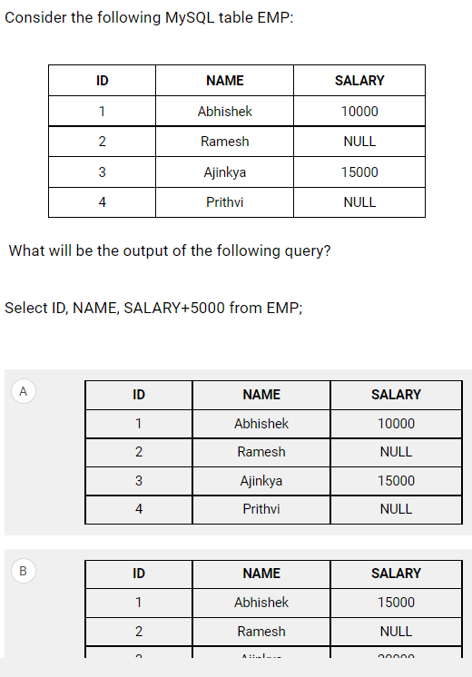
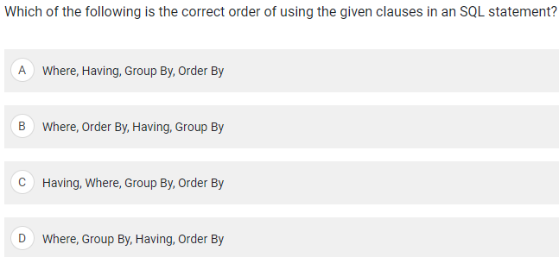
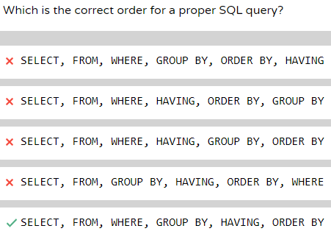

Slide 5


Slide 6
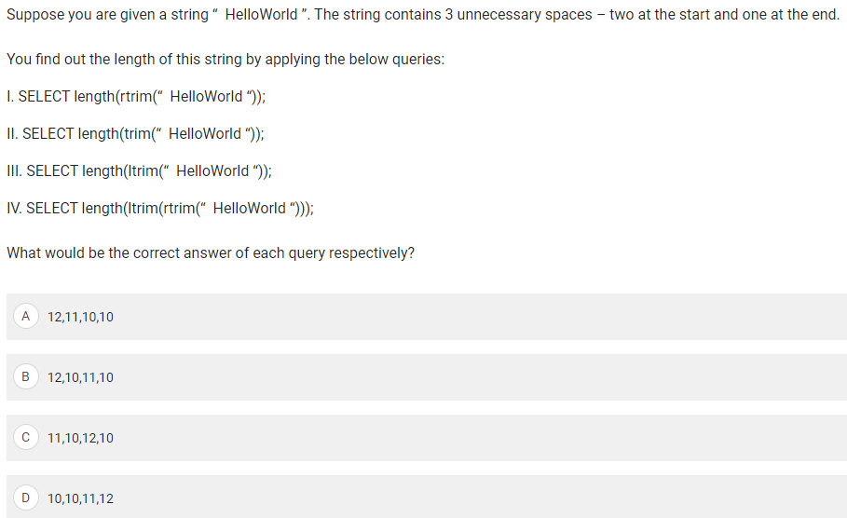

Slide 7
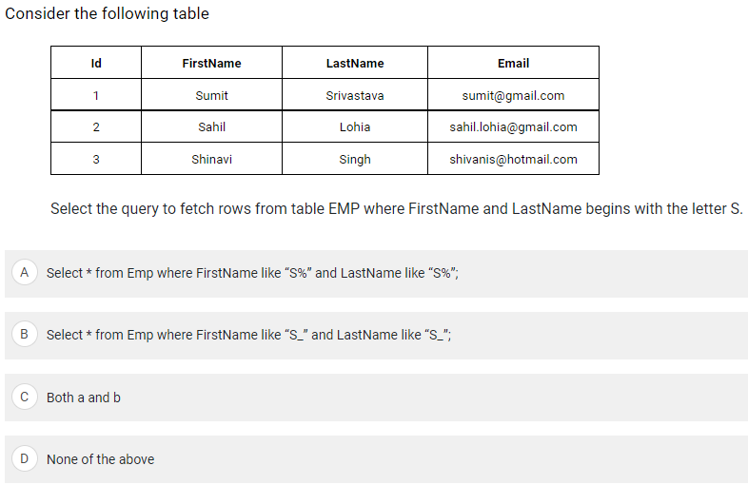

Slide 8
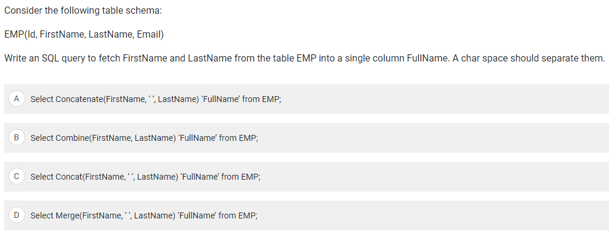

Slide 9
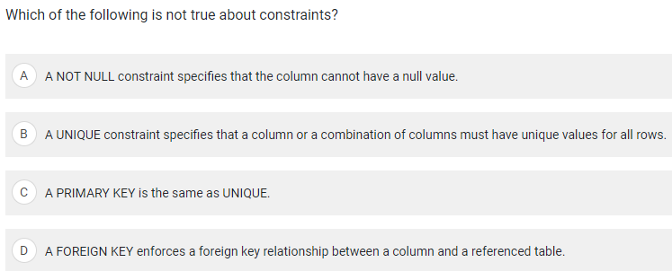

Slide 10
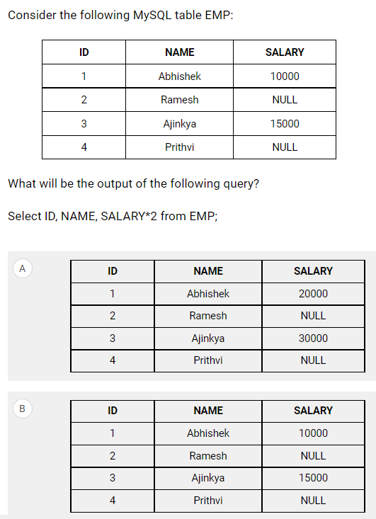

Slide 11
ML

Slide 12
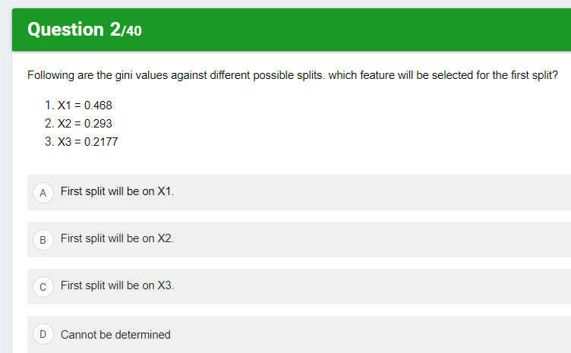
A feature with a lower Gini index is chosen for a split.

Slide 13
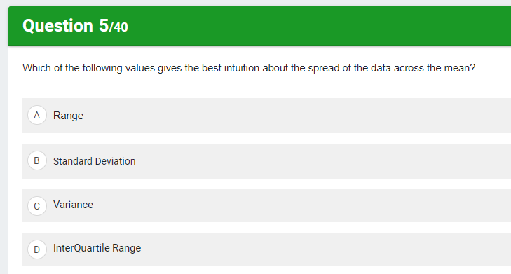

Slide 14
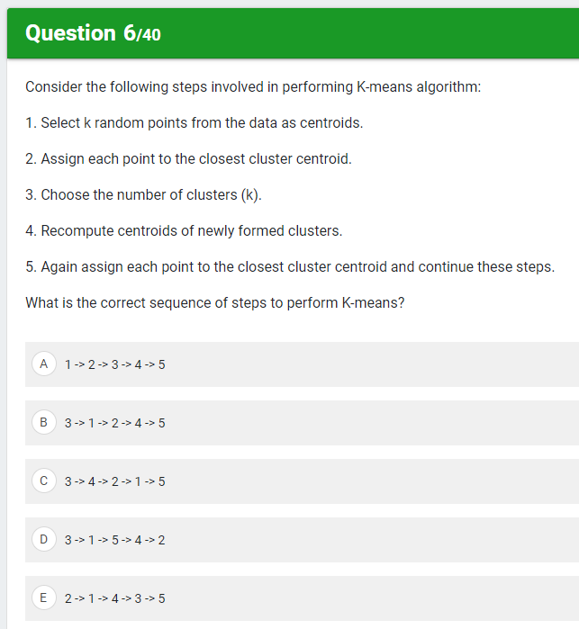
https://medium.com/data-folks-indonesia/step-by-step-to-understanding-k-means-clustering-and-implementation-with-sklearn-b55803f519d6
3
1
2
4
5

Slide 15
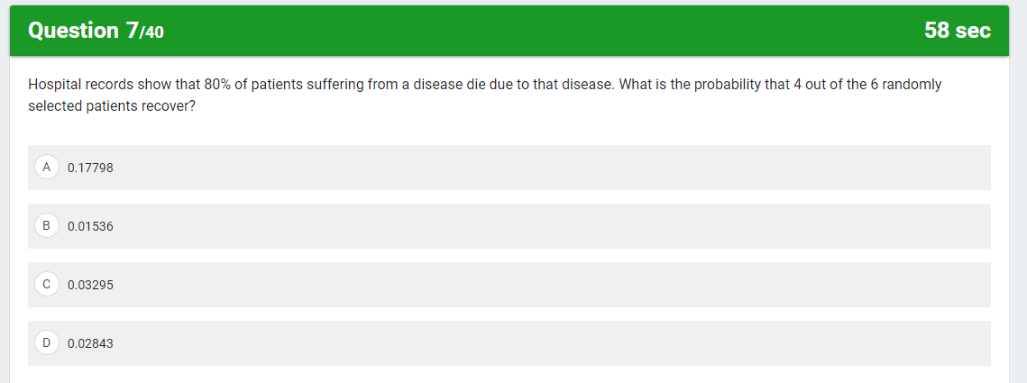

Slide 16
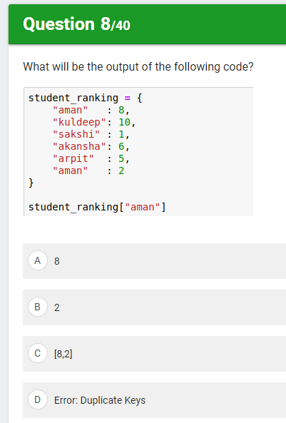

Slide 17
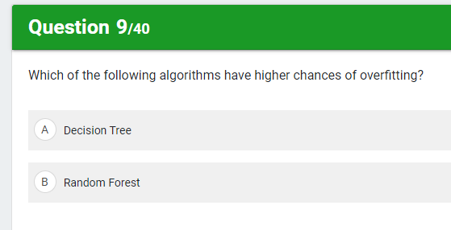

Slide 18
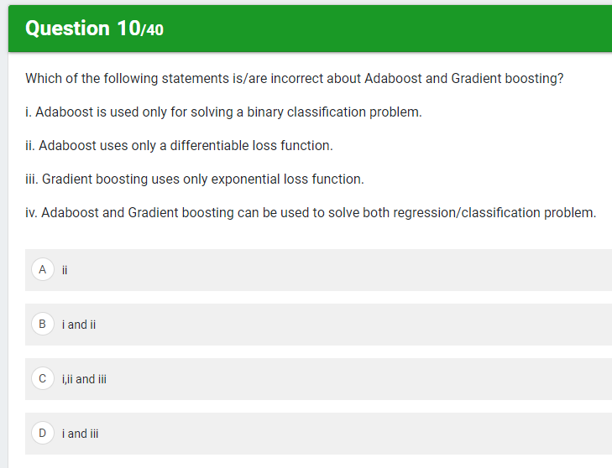
AdaBoost algorithms can be used for both classification and regression problem
Gradient Boosting Trees can be used for both regression and classification
AdaBoost minimizes exponential loss function
Gradient Boosting, any differentiable loss function can be utilised.
A multi-class classifier-based AdaBoost algorithm for the efficient classification of multi-class data is proposed in this paper. The traditional AdaBoost algorithm is basically a binary classifier and it has limitations when applied to multi-class data problems even though its multi-class versions are available.

Slide 19
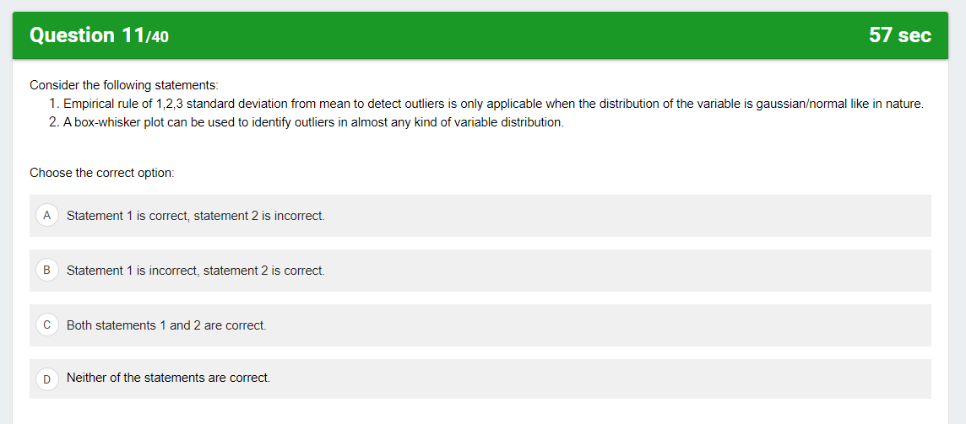
https://www.simplypsychology.org/boxplots.html --> boxplot
https://corporatefinanceinstitute.com/resources/knowledge/other/empirical-rule/ → Empirical rule

Slide 20
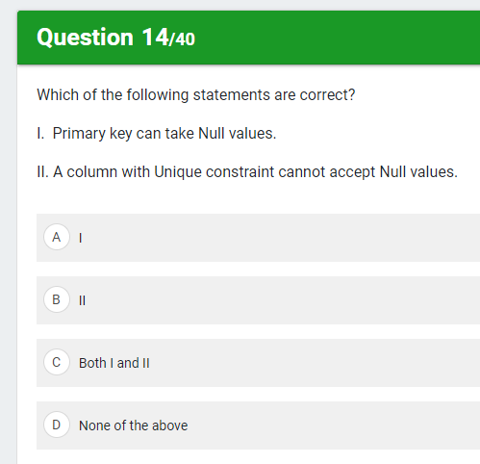
No. We can't have a Primary Key column with a NULL value. The reason for the same is very simple, primary key purpose is to uniquely identify records. ... This is the reason; Primary Key can't have NULL values as they are not compared with any other value.
You can insert NULL values into columns with the UNIQUE constraint because NULL is the absence of a value, so it is never equal to other NULL values and not considered a duplicate value. This means that it's possible to insert rows that appear to be duplicates if one of the values is NULL

Slide 21
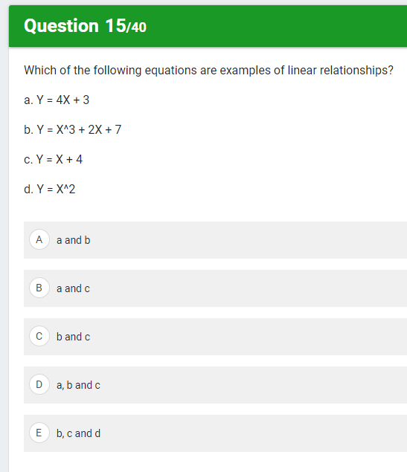
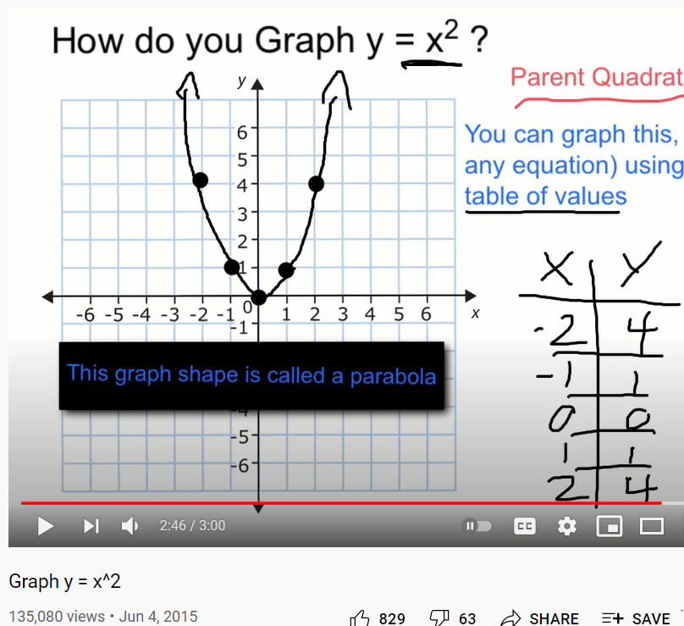
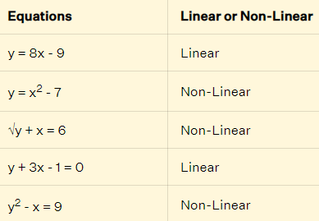

Slide 22
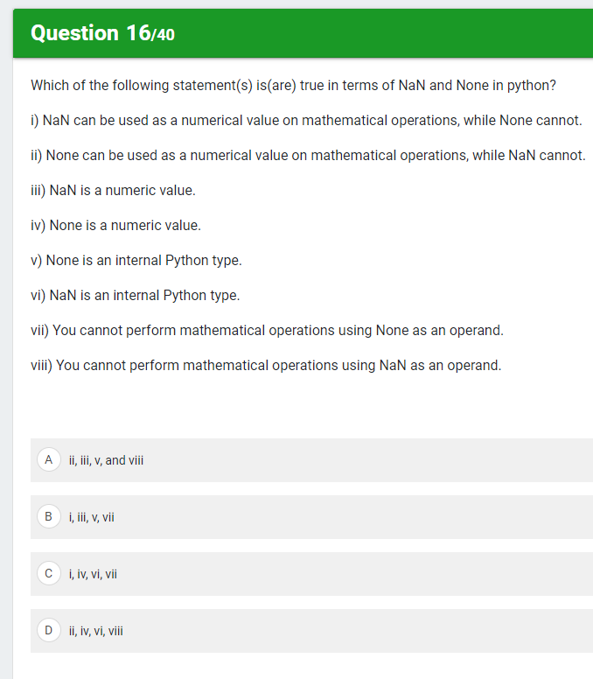
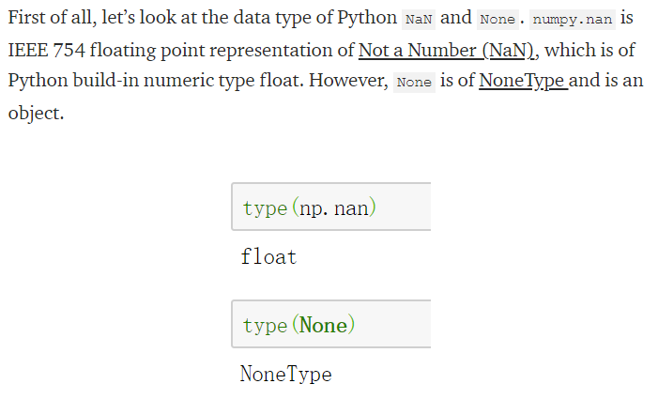
As summary, NaN and None are different data types in Python. However, when it comes to missing values detection and elimination, pandas.DataFrame treats NaN and None similarly. To detect missing values, df.isnull() returns True for both NaN and None. To eliminate missing values, df.fillna() also works for NaN and None.
NaN can be used as a numerical value on mathematical operations, while None cannot (or at least shouldn't).
you cannot perform mathematical operations using None as operand.

Slide 23
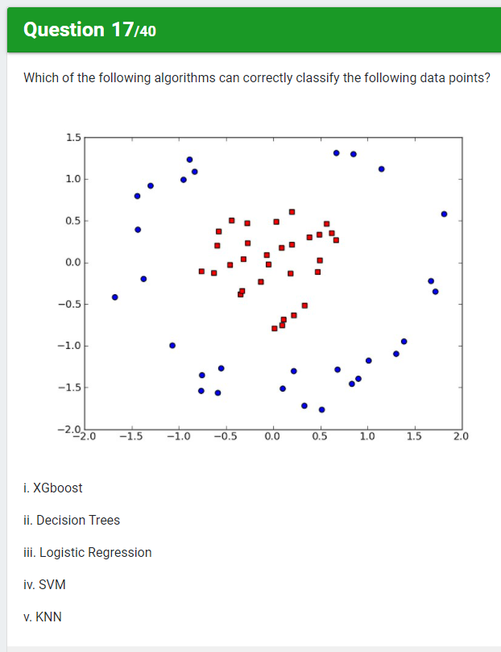

Slide 24
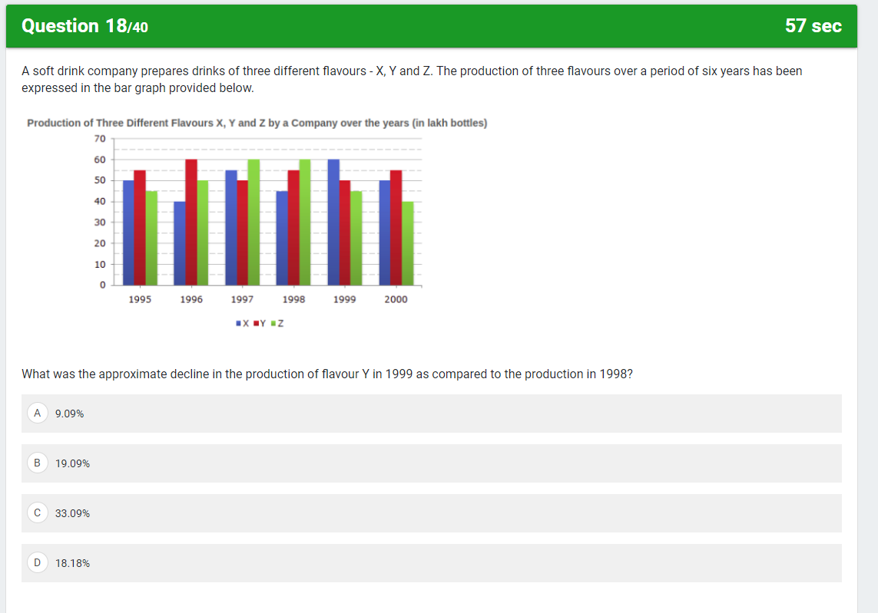
1999 → 50
1998 → 55

Slide 25
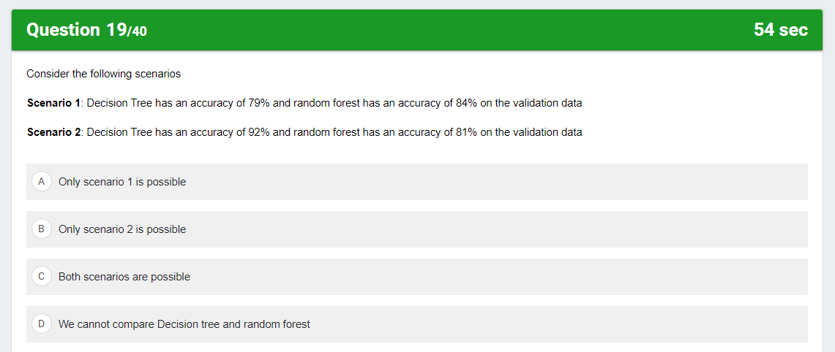

Slide 26
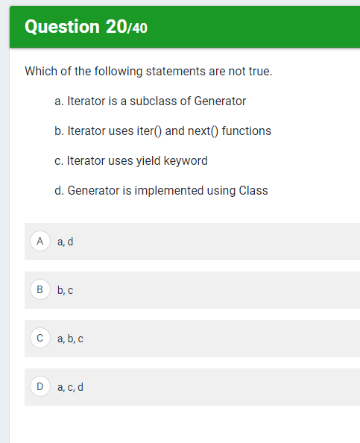
generator vs iterator
In creating a python generator, we use a function. But in creating an iterator in python, we use the iter() and next() functions.
A generator in python makes use of the ‘yield’ keyword. A python iterator doesn’t.
You can implement your own iterator using a python class; a generator does not need a class in python.
Generator in python is a subclass of Iterator. To prove this, we use the issubclass() function.

Slide 27
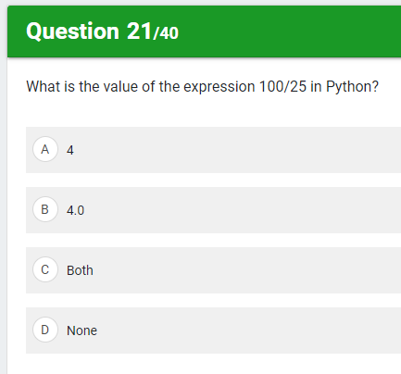

Slide 28
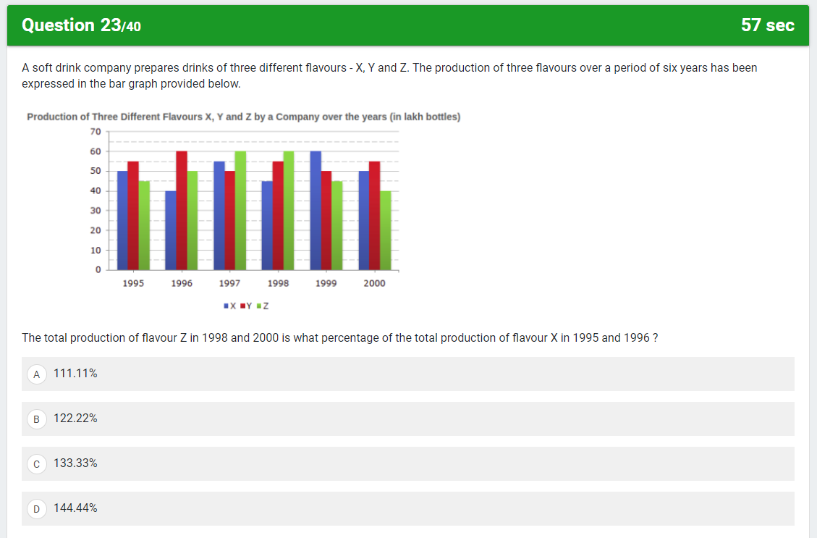
60 + 40 = 100
50 + 40 = 90

Slide 29
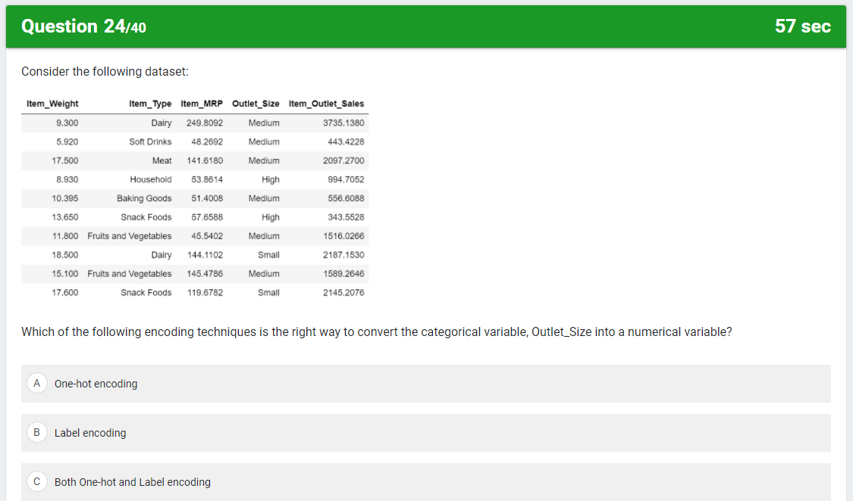
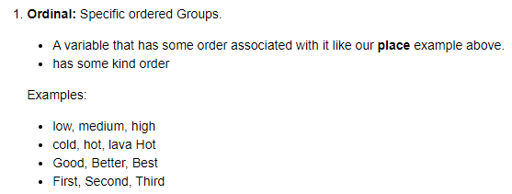
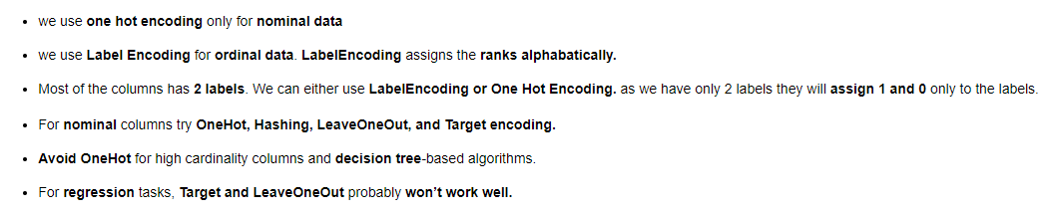

Slide 30
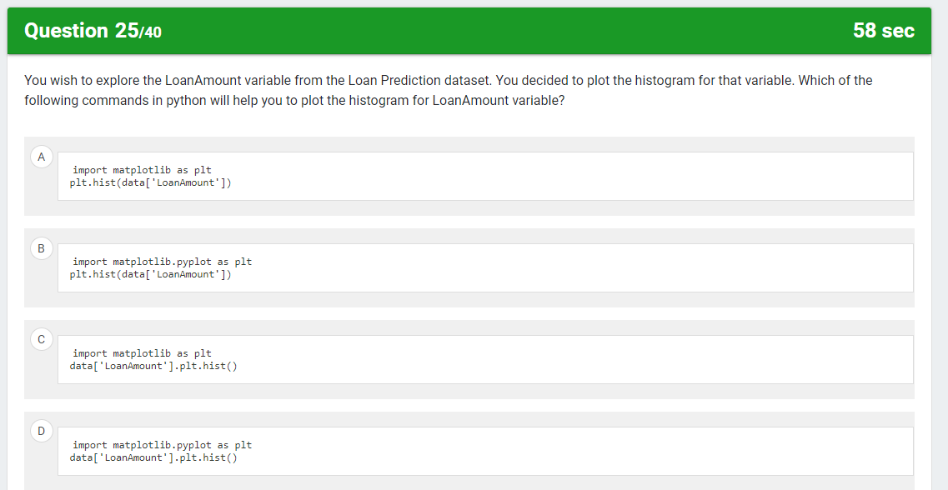

Slide 31
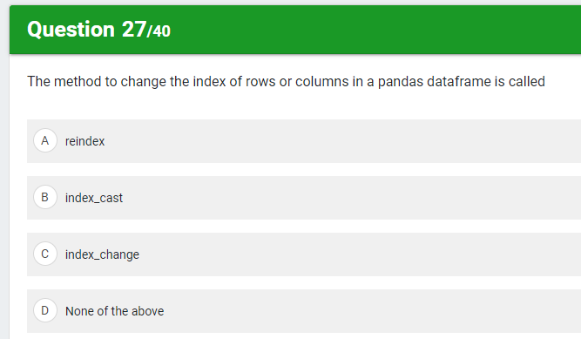
https://www.geeksforgeeks.org/reindexing-in-pandas-dataframe/

Slide 32
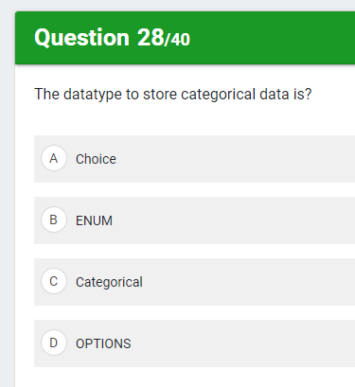

Slide 33
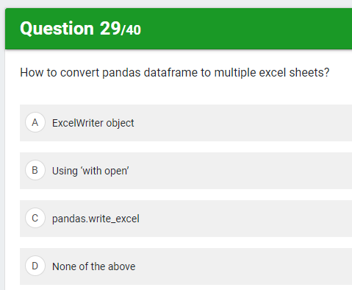
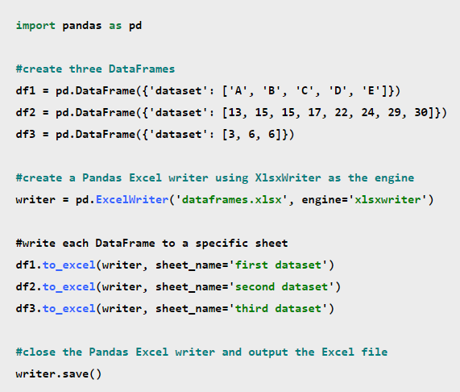
Fortunately this is fairly to do using the pandas ExcelWriter() function. In order to use this function, you first need to make sure you have xlsxwriter installed:
pip install xlsxwriter
You also need to make sure you have xlwt installed:
pip install xlwt

Slide 34
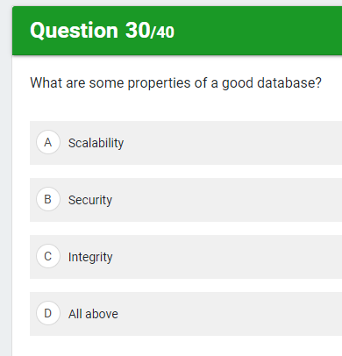

Slide 35
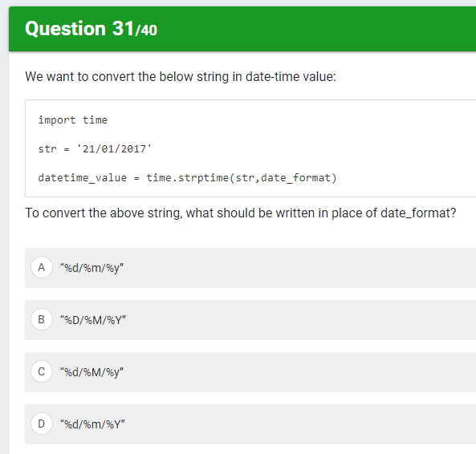

Slide 36
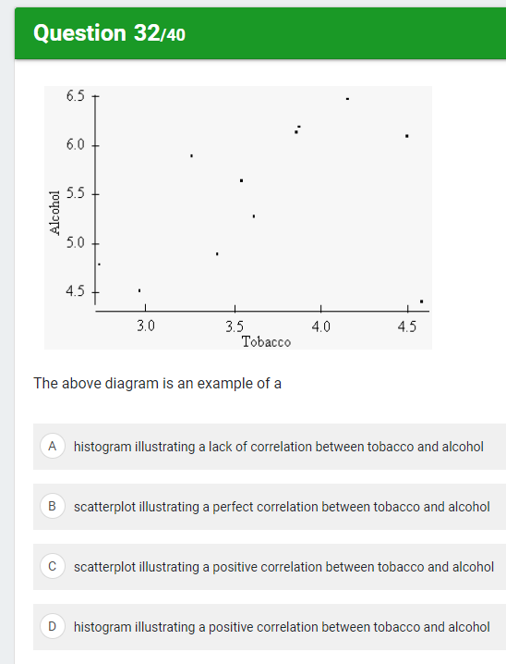

Slide 37
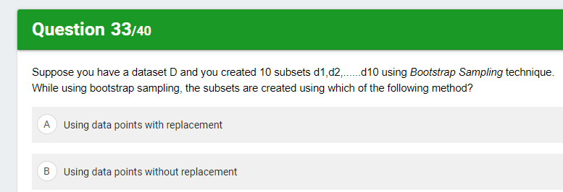

Slide 38
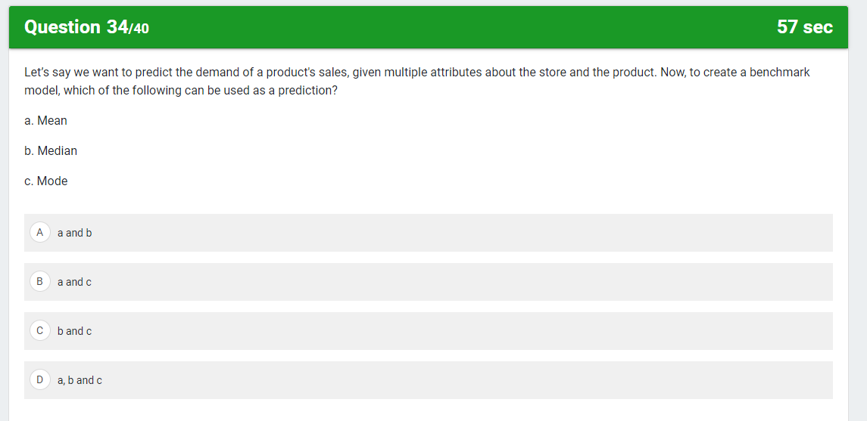

Slide 39
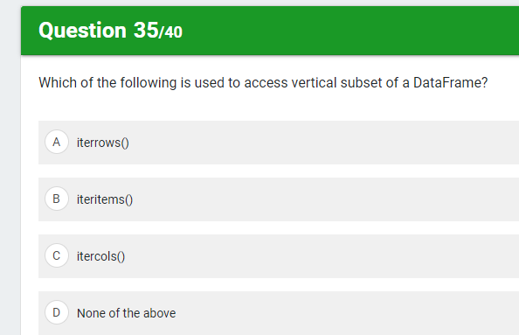
3. Which method is used to access horizontal subset of a dataframe? (a) iterrows() (b) iteritems() (c) mod() (d) median()

Slide 40
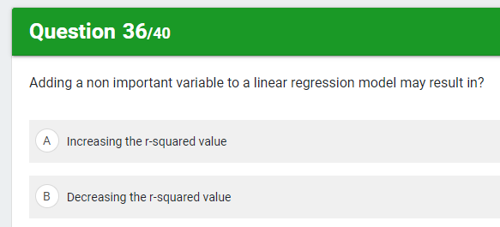
After adding a feature in feature space, whether that feature is important or unimportant features the R-squared always increase.

Slide 41
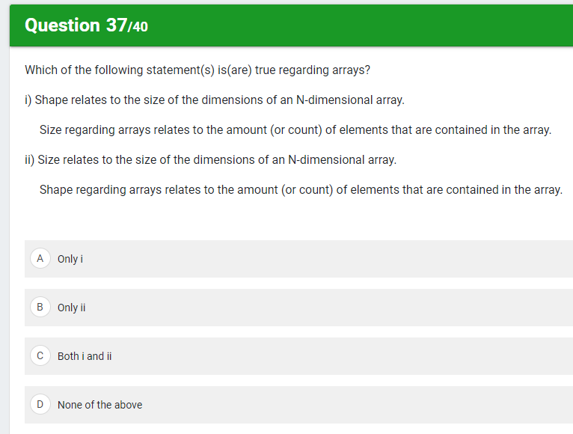

Slide 42
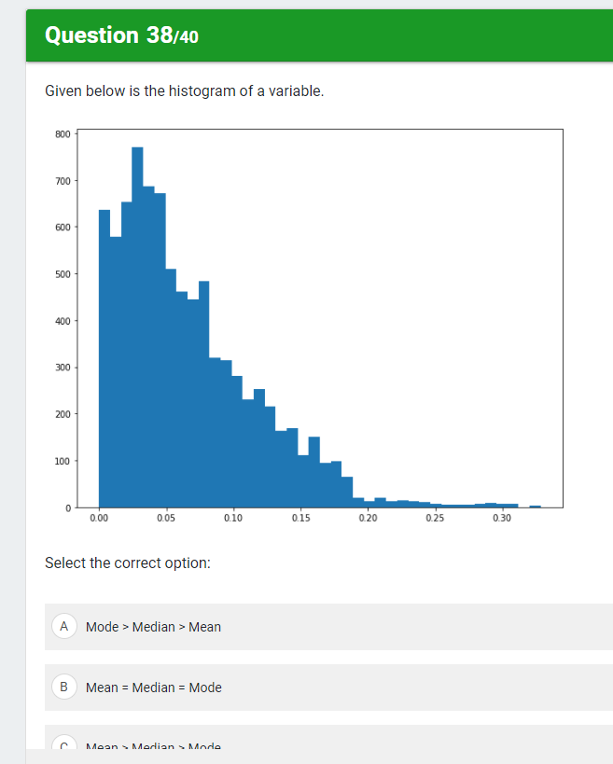
Mean > Median > Mode

Slide 43


Slide 44


Slide 45
https://towardsdatascience.com/understanding-feature-engineering-part-2-categorical-data-f54324193e63 ---> Encoding

Slide 46


Slide 47


Slide 48


Slide 49


Slide 50


Slide 51


Slide 52


Slide 53


Slide 54


Slide 55


Slide 56


Slide 57


Slide 58


Slide 59


Slide 60


Slide 61


Slide 62


Slide 63


Slide 64


Slide 65

IQR = Q3 – Q1 = 170-100 = 70

Slide 66


Slide 67


Slide 68


Slide 69


Slide 70


Slide 71


Slide 72


Slide 73


Slide 74


Slide 75


Slide 76


Slide 77


Slide 78


